Slide 1
Week 7
Advanced Image Processing
Face Detection
Notes:
Things to improve:
Confusion about copying into/out of OS-provided buffers

Slide 2
Face Detection
This is a common problem, many solutions exist
Some faster, some slower, some more accurate, etc….
We’re going to look at two:
Eigenfaces
Viola-Jones
We’re only going to implement the latter
The former is just to think about techniques for signal processing!

Slide 3
Eigenfaces
Eigenfaces relies on the concept of principal component analysis (PCA)
Takes a lot of data in, finds common components, or patterns
Often viewed in terms of “trials”
E.g. “Across all trials”, what remains constant?
Often used in machine learning
Is able to look at a dataset and discern simple patterns

Slide 4
PCA Theory
Singular Value Decomposition on a matrix X
That’s the same thing as Eigenvalue Decomposition on the matrix X^{T}X
Decomposes X into U, S, V such that:
S is a diagonal matrix of singular values
These control the weighting of the singular vectors
U, V are the left and right singular vector matrices
The columns of U and the rows of V represent bases for the signal space

Slide 5
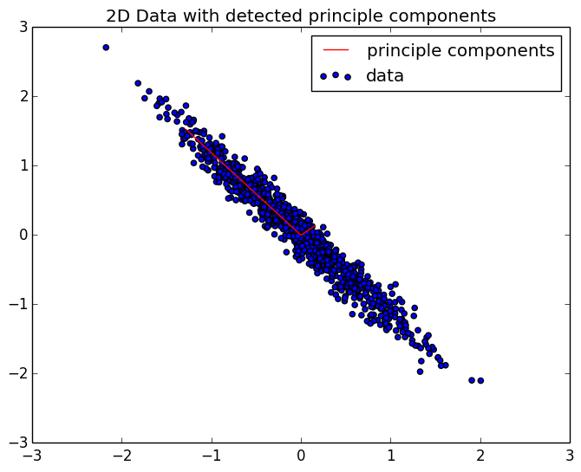
PCA Theory
PCA will transform X onto a specific basis
The basis are those which “best describe” X, in an energetic sense

Slide 6
PCA Live Demo
See final result here

Slide 7
Eigenfaces
We use PCA to learn the overall structure of a face
The overall structure of a face will become a single principle component
We represent an image of a face as an N-D vector
We construct matrix X with multiple images of faces
The components of the images that are consistent are the PC’s

Slide 8
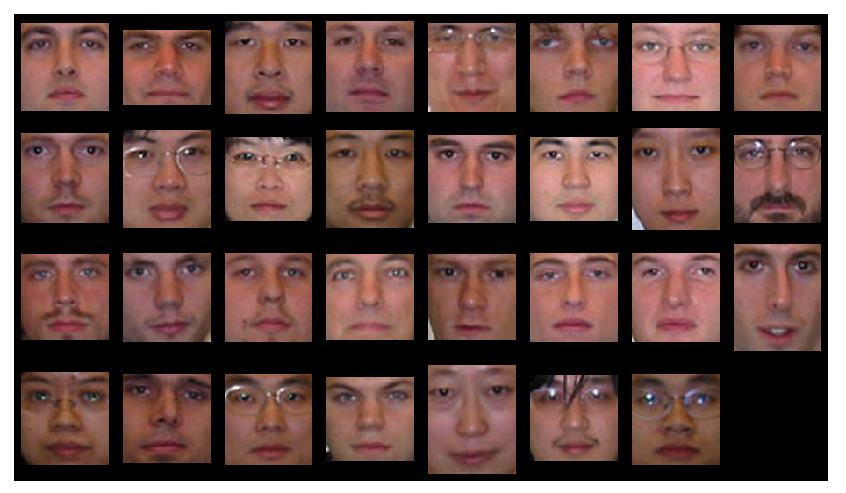
Eigenfaces

Slide 9
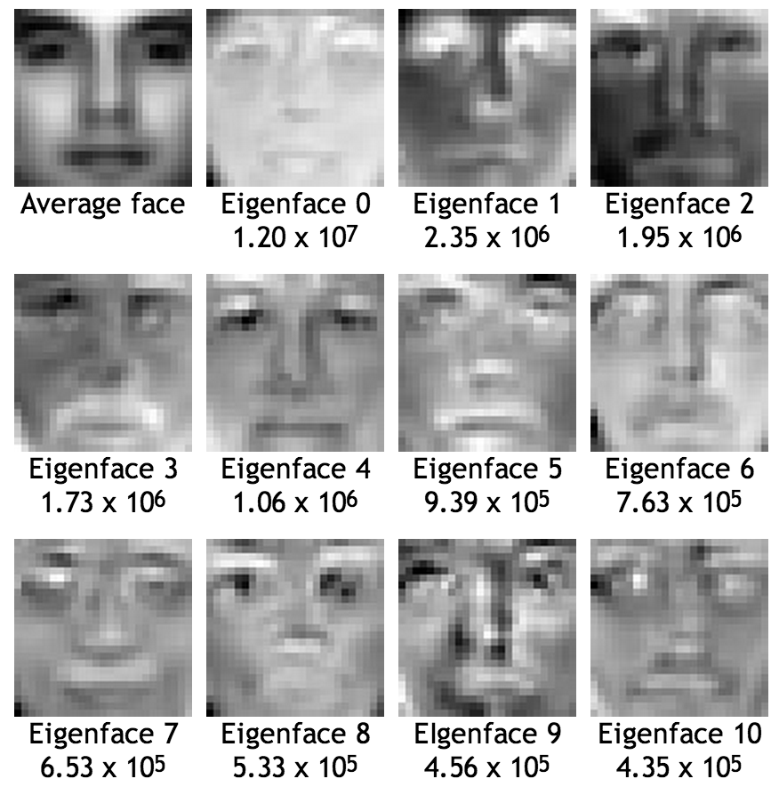
Eigenfaces

Slide 10
Eigenfaces
To detect a face, we decompose a test image
Using the same eigenvectors (or “eigenfaces”) as found earlier in training
If the eigenvalues of this image are close enough to those we found in training on real faces, it’s a face
Each eigenvalue represents the weight of that eigenface
Weight == contribution of that eigenface to the overall image
We do this decomposition for every possible subimage
Classifying each as a face or as not a face

Slide 11
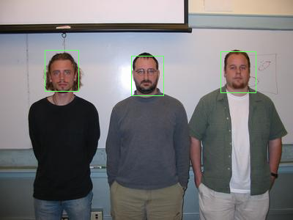
Eigenfaces

Slide 12
Viola-Jones
Viola-Jones is an object detection framework
Not just faces, but commonly used for such
Uses a cascade of “weak classifiers”
Each classifier is very simple, uses a single computationally easy feature
The result of all classifiers is combined into a single decision
The classifiers use a “Haar-like” feature
Basically, black and white rectangles

Slide 13
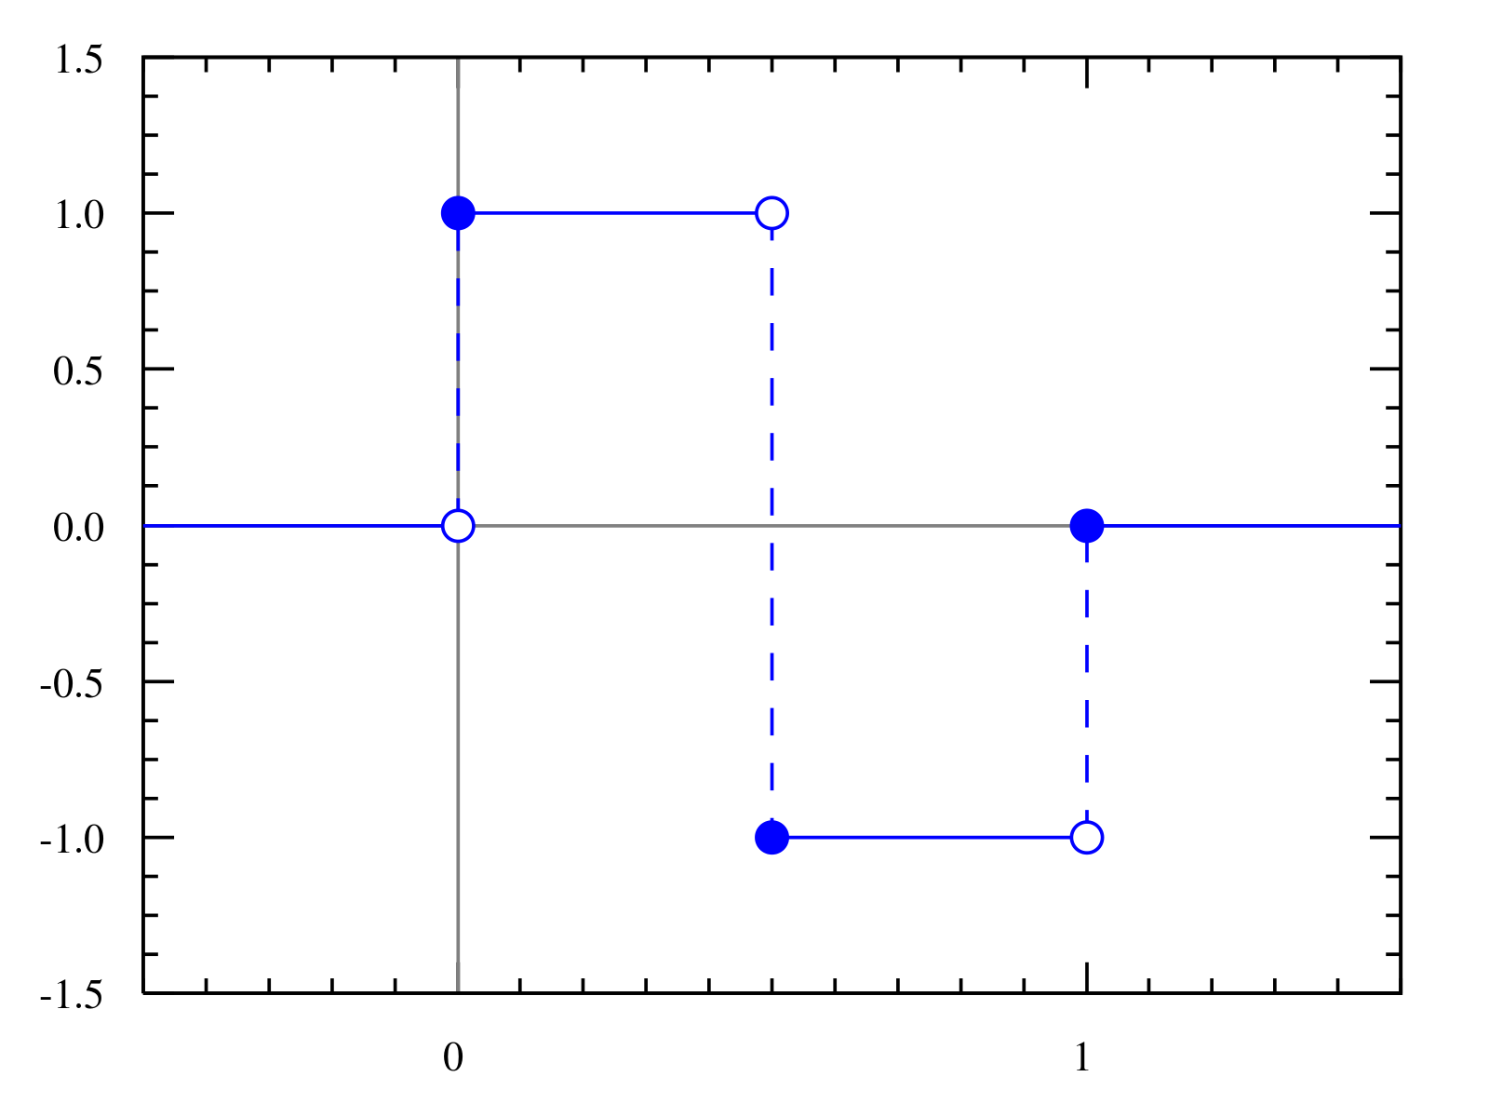
Features
The Haar wavelet

Slide 14
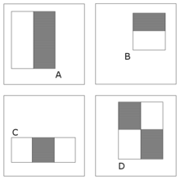
Features
Two-dimensional, Haar-like features

Slide 15
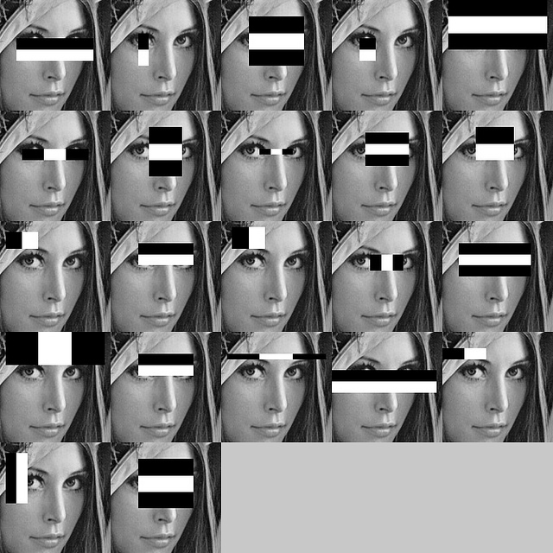
Features
These features are then correlated with our signal

Slide 16
Classifier Cascade
Using the output of one feature, make a decision
This will not be very accurate!
Cascade these classifiers for the final decision
Classifier 1
Classifier 2
Classifier N
Not a face
Face!

Slide 17
Classifier Cascade
All the intelligence is in the ordering of classifiers
This “ordering of classifiers” is essentially our model
This is built offline, using lots of training data
The most reliable features are used first, the lesser ones last
Use Machine Learning to create this model!
Most implementations use something called AdaBoost
This chooses the best features, and orders them for our model

Slide 18
Learning the Cascade
The number of possible features is enormous
Remember, our features look across permutations of scale as well!
For a 24x24 pixel window, there are 162,332 features
This is just too many to use all at once
AdaBoost will pick the ones that are most useful
“Useful” – Highest accuracy
Iteratively chooses features that complement existing weaknesses

Slide 19
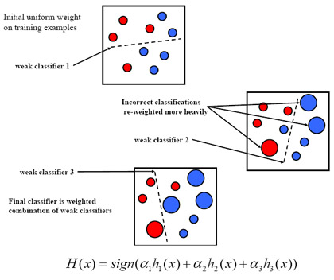
Learning the Cascade

Slide 20
Learning the Cascade
AdaBoost isn’t something you write yourself
In fact, oftentimes you don’t even need to use it
Preexisting models are available on the internet for our use
The OpenCV project has pre-learned cascades
Not only for faces, but an array of objects
Stored as .xml files describing the cascade of classifiers
Also contains methods for learning your own cascades given data

Slide 21
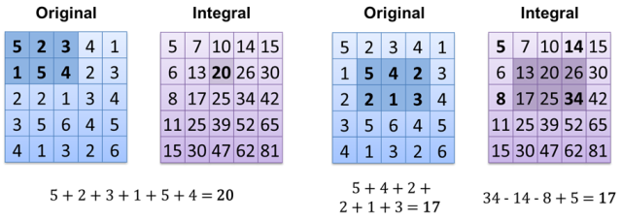
Using the Cascades
Evaluating all features on all subimages is slow
Way, way, way, too slow, even for desktop computers
However, there is a cheat we can use
We can calculate the integral image

Slide 22
Using the Cascade
This allows a single feature to be calculated quickly
Really, really, quickly! Four additions, regardless of the size of the feature!
Almost all the work is then in doing the integral
A small price to pay!
This is what allows this kind of detection to be done in real-time on a desktop computer
We can get close on our phones, we need to run at a low resolution

Slide 23
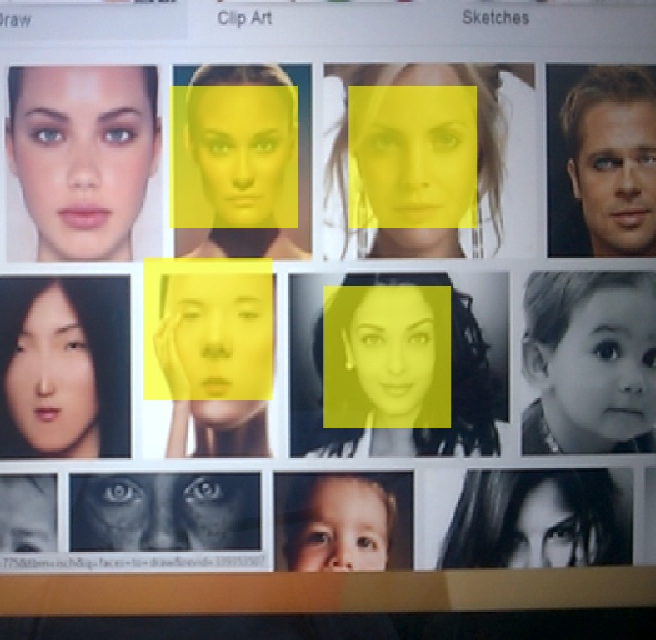
“Live” demo
Again, this doesn’t work too well on the emulator
So instead, here’s a screenshot from the example App!

Slide 24
Bonus Slide: CV Dazzle
I came across this while researching Viola-Jones
CV Dazzle, hairstyles and makeup designed to counteract facial recognition algorithms
Purposefully disrupts the features discussed today
Breaks up the “rectangular” features
Causes the weak classifiers to fail miserably

Slide 25
Network Comms
We’ve already got a little experience with this
Started out with Bluetooth, using RFCOMM to use BT as a serial device
Basics stay the same for TCP/IP, because RFCOMM is similar to TCP
We’ll connect to ports, deal with streams, etc…
Once again the likes of DataReader, and friends will help us out
We’ll then take a higher-level approach
HTTP is a protocol built on top of what we’re talking about
On top of HTTP, we’ll talk about a data serialization format; JSON
By the end, we’ll be doing live speech recognition!

Slide 26
TCP/IP
Provides reliable end-to-end data transmission
Reliable: If something bad happens, it’ll retransmit
End-to-end: You don’t need to explicitly worry about middlemen
You connect to the destination, and the middle takes care of itself
Has the concept of a session, which must be established beforehand
UDP, on the other hand, is unreliable
Doesn’t retransmit if something goes wrong
Has no concept of a session; every packet is independent of every other
Both have the concept of Sockets
Bound to a port number, differentiates different services from eachother
E.g. HTTP servers listen for new connections on port 80

Slide 27
TCP Sockets
TCP Sockets can either listen, or connect
Once they are connected, provide 2-way, stream-based communication
Listening sockets are used by servers
Bind to a port
Creates a new socket when a client connects to it
Connecting sockets initiate the connection
Connect to a server address at a certain port
Due to the nature of phones, we tend to connect
Running background listening services on a phone is rare, but possible

Slide 28
Listening
We do this with StreamSocketListener
Exposes a ConnectionReceived event
We call BindServiceNameAsync(portnumber) to start listening
Everything afterwards happens in the event handler
We are passed in a StreamSocketListenerConnectionReceivedEventArgs
Feel free to laugh at that name, it deserves it
Inside that args class, we can get at the Socket member
Once we have that StreamSocket, we’re done
We can construct DataReaders, DataWriters, etc…

Slide 29
Connecting
Extremely similar to connecting over Bluetooth
We’re not going to use PeerFinder
If you want to, go ahead and search for docs, examples, etc…
We’ll just assume we know the address of the listening socket
First, we create a HostName object from a string
We feed that into ConnectAsync:
StreamSocket s = new StreamSocket();
HostName hostname = new HostName(hostnameString);
await s.ConnectAsync(hostname, portString);
After that, we are ready to do work with the socket
Again, DataReaders, DataWriters, etc… are your friends

Slide 30
Raw TCP/IP Demo

Slide 31
HTTP
HyperText Transer Protocol
Proposed by Sir Tim Berners-Lee in 1991
A stateless, request-response text-based protocol
Clients initiate requests, servers respond
Many technologies exist to address the lack of server initiation
WebSockets, AJAX, XMLHTTPRequest to name a few
Each request is independent of all others, no information is stored
Hence, cookies
Each response starts with an HTTP status code
404 – File Not Found, 200 – OK, 500 – Internal Server Error etc….
A limited number of request types can be made
Most common: HEAD, GET, POST

Slide 32
HTTP Requests
HEAD
Retrieves metadata about a file on a server
Time last modified, file contents type, etc…
GET
Most common by far, “gets” the data stored on the server
POST
Performs the same function as GET, but allows client to upload data
While GET does allow for small amounts of data to be URL-embedded, POST allows for much larger chunks to be sent like a GET response
Note that all of these can fail, with 404’s, 500’s, etc.

Slide 33
HTTP Headers
Headers are metadata that precedes all messages
Both requests and responses provide headers
Even request type is part of the header
Controls/describes the communication channel as well as the content being transferred
Content-Length describes the length of a GET response or a POST upload
Connection-type: [Close/Keep-alive] determines whether the socket is closed after the first request, or is kept open for further communication
Many, many others exist
HEAD, unsurprisingly, gets only the headers for a file

Slide 34
Example HTTP request
We can type out a simple HTTP request:
GET / HTTP/1.1
It’s impossible to see here, but all HTTP messages end with two sequential newlines: \r\n\r\n
The response looks like so:
HTTP/1.1 200 OK
Server: nginx/1.2.6
Date: Fri, 22 Feb 2013 00:43:24 GMT
Content-Type: text/html
Content-Length: 16
Last-Modified: Wed, 03 Oct 2012 21:52:51 GMT
Connection: keep-alive
Accept-Ranges: bytes
<data>

Slide 35
Raw HTTP Demo

Slide 36
Using HTTP in C#
Luckily, we don’t have to do all this by hand
There are a LOT of HTTP-centric tools for use, in every language
In C#, we use HttpWebRequest:
HttpWebRequest request = WebRequest.CreateHttp( url );
We then use .{Begin,End}GetResponse:
var response = await Task.Factory.FromAsync<WebResponse>(
request.BeginGetResponse, request.EndGetResponse, null));
Finally, we can construct a DataReader:
new DataReader(response.GetResponseStream().AsInputStream());

Slide 37
HTTPWebRequest Demo

Slide 38
Beyond HTTP
Okay, we have the communication set up
We still aren’t saying anything interesting, just “give me file X”
To communicate more complex ideas, we use:
Our own, non standards-conformant language that we will reinvent for every new project, and which decides not to work on Tuesdays
XML: A generalized markup language. We use this every day with XAML
JSON: “Javascript Object Notation”, a serialization format born in the web
Protocol Buffers: Completely overkill, but a neat idea
We’re going to use JSON, because it’s easy
Very straightforward
Extremely common, especially among web services
Because the next demo relies on it

Slide 39
Google Speech API
Provides a webservice endpoint for Speech -> Text
https://www.google.com/speech-api/v1/recognize?lang=en-US
Note the URL-encoded parameter setting language
Takes in FLAC-encoded audio files via POST
FLAC: Free Lossless Audio Codec
Almost certainly has a duration limit, feel free to experiment!
Gives back a JSON response of text hypotheses
Guaranteed to be the simplest free speech recognition API in the world
Let’s take a look at the demo!

Slide 40
Google Speech Demo

